Slide 1
AI Landing Zones in Azure
The secure and governed foundation for pro-code agents
Christina Pardali · AI Infrastructure Summit 2026
09:20 - 09:45
Note: The views I am expressing are my personal beliefs, and I am not speaking or acting
on behalf of Microsoft.

Slide 2
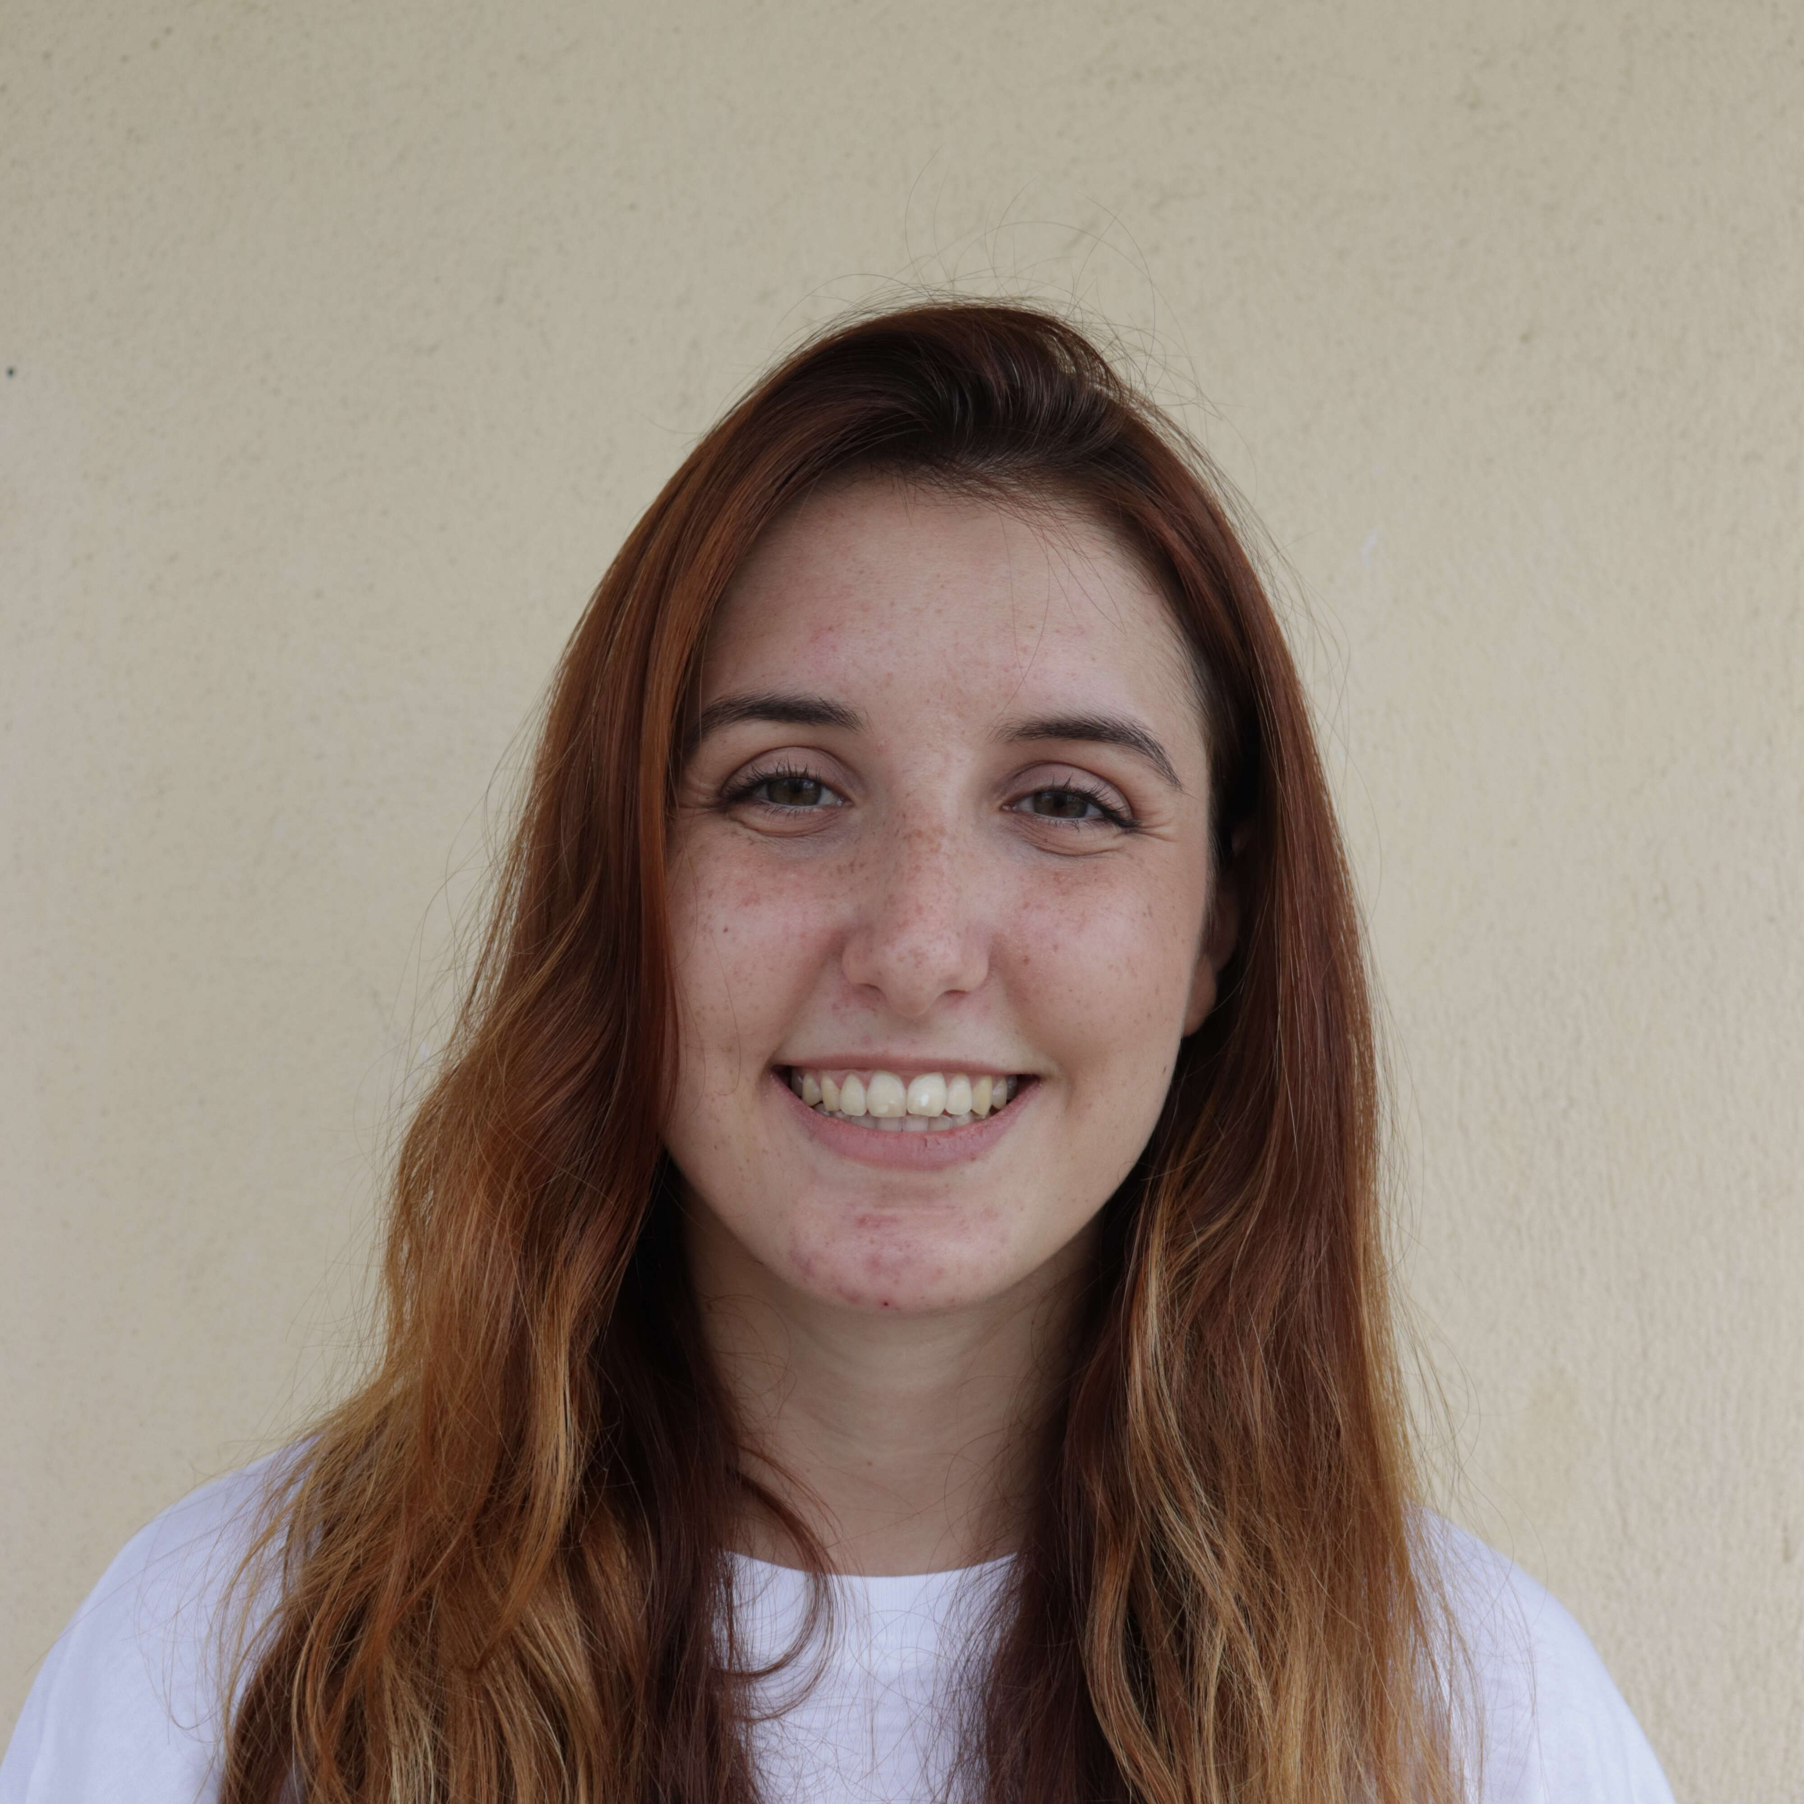
WHO AM I
A bit about me
ROLE
Partner Solution Architect at Microsoft (EMEA)
FOCUS
Agentic AI and GitHub
Christina Pardali
Partner Solution Architect
Microsoft · EMEA
COMMUNITY
Communications Lead for Microsoft's Mosaic Inclusion Network in Germany

Slide 3
What we’ll cover
Why enterprise AI needs a purpose-built foundation
The shift to agents & pro-code development with Microsoft Foundry
What an Azure AI Landing Zone is — and what it isn’t
The reference architectures and the pillars we advise getting right

Slide 4
Where do organizations get stuck?
Agentic AI
Systems
←
→
5
Incremental Business
Outcomes
AI-led Business
Transformation
Benefits
Benefits
Production AI in
Core Processes
Governance
Development
Development
Infrastructure
Production AI
in Periphery
4
Infrastructure
Benefits
Users
Users
Proof of
Concept
Users
Benefits
3
Governance
Intent
Benefits
2
Governance
Development
1
Development
Infrastructure
Infrastructure
Users
Users

Slide 5
Two Key Questions
“Our POC works - how do we get to secure, repeatable
production?”
“How can we ensure consistency across departments when
adopting AI?“

Slide 6
More questions we get from our customers and partners
How do we adopt GenAI without exposing sensitive data or leaking IP?
Can we keep AI private - no public endpoints, on our own network?
How do we prevent token and compute spend?
Many teams want AI - how do we control access and set guardrails?

Slide 7
AI Adoption Framework
AI Ready - Cloud Adoption Framework | Microsoft Learn

Slide 8
Multiple ways to build agents — we focus on pro-code
OUR FOCUS TODAY
Microsoft 365 Copilot
Buy — ready-made
Prebuilt AI assistant embedded across Microsoft 365.
Copilot Studio
Extend — low-code / no-code
Makers build and publish agents fast in a graphical studio.
Microsoft Foundry
Build — pro-code
Full control: custom agents, models, orchestration, evaluation and enterprise governance.
No-code / low-code → pro-code · more customization & control
You can build agents low-code with Copilot Studio — today we focus on Microsoft Foundry, the pro-code path where you customize and control the most.

Slide 9
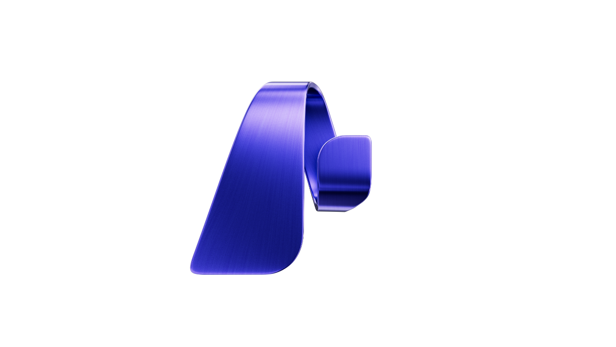







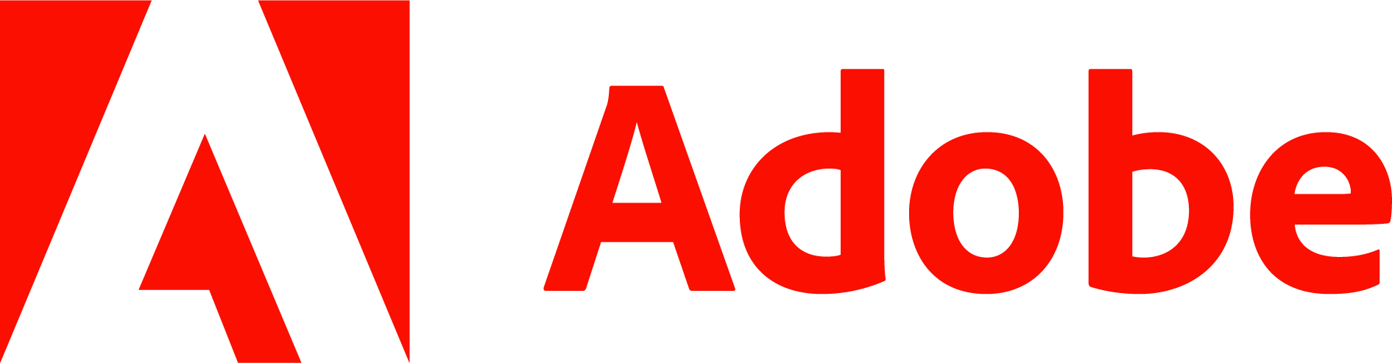


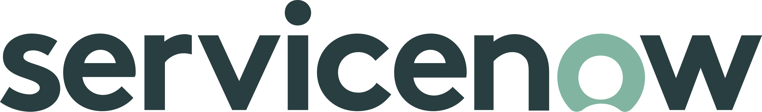





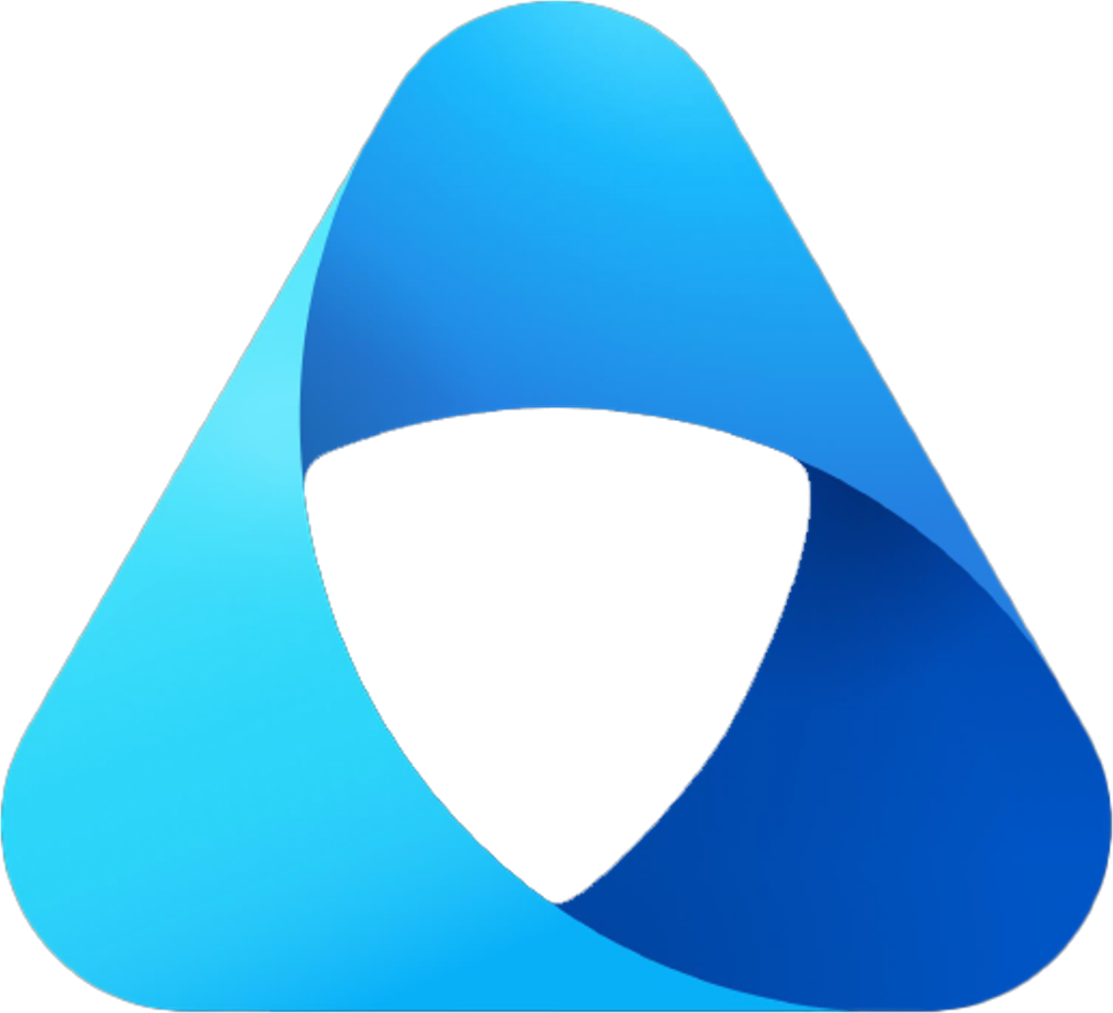

Microsoft Foundry
Streamline development with native IDE experiences
GitHub
Visual Studio
Visual Studio Code
Copilot Studio
Models
Agent Service
IQ
Tools
Machine Learning
Build context-aware and action-oriented agents with 1,400+ pre-built connections and MCP tools
Microsoft Bing
Microsoft Fabric
Microsoft OneLake
Control Plane
Leverage a complete signals management layer with Microsoft Security integrations
Microsoft Agent 365
Microsoft Defender
Microsoft Purview
Microsoft Entra
Security, compliance, and governance

Slide 10
01
Starting a journey based on best practices with a start-to-finish plan is a key factor for success
What are landing zones for?
02
Creating well-designed foundations for a cloud environment will enable the safe adoption of new technologies, at pace
03
Using consistent, repeatable environment designs helps scaling out in a manageable way

Slide 11
Azure Landing Zone Customer Journey
Bootstrap your environment
Deploy Azure Landing Zone Platform components
Subscription (LZ) Vending Process
Landing Zone Accelerators
Whether you are a Brownfield or Greenfield customer, if you are looking to implement a new ALZ environment based upon best practice then you will require multiple subscriptions created. The below articles will refer you to manual and programmatic creation methods.
Accelerate the deployment of platform resources based upon ALZ conceptual architecture. Deployment options available via Portal, Terraform and Bicep to assist with the deployment of management group hierarchy, governance baseline, connectivity, management and security components.
To accelerate the deployment of individual landing zones within an Azure tenant, a subscription vending solution is recommended to help deploy a subscription and the core resources, e.g., networking. Subscription vending is available using both Terraform and Bicep.
There are multiple Landing Zone Accelerators that provide a specific architectural approach and reference implementation for preparing landing zone subscriptions for an enterprise deployment, e.g. Azure Virtual Desktop, SAP, AKS etc.. These Accelerators are available in a wide range of deployment options.
Create Platform Subs
Create Platform
LZ Vending
Deploy Workload
Create Subscriptions Manually
ALZ Accelerator (Portal)
AKS Accelerator
APIM Accelerator
App Svc Accelerator
LZ Vending Module (Terraform)
Create Subscriptions Programmatically
ALZ Bicep Modules
ALZ Terraform Module
Arc Servers Accelerator
Arc K8S Accelerator
SAP Accelerator
LZ Vending Module (Bicep)
LZ Vending Modules
AVD Accelerator
AVS Accelerator
Cloud Scale Analytics Accelerator
*Sequencing considerations
AI Landing Zone

Slide 12
What’s a workload-specific ALZ?
• Solution and scenario-specific landing zone
• Focuses on the workload – For example AI
• Has its own design considerations and recommendations
• Has its own reference implementation
20% AI Use Case
30% AI Landing Zone
S P E C I A L I Z A T I O N
50% Azure Landing Zone

Slide 13
AI Landing Zones
▦
⬡
❖
Design Framework
Reference Architecture
Extensible Implementation
Terraform
Cloud Adoption Framework
AI Foundry Landing Zone
Bicep
Well Architected Framework
AI Gateway Landing Zone
Portal
Azure Architecture Center
Supports the Platform Landing Zone

Slide 14
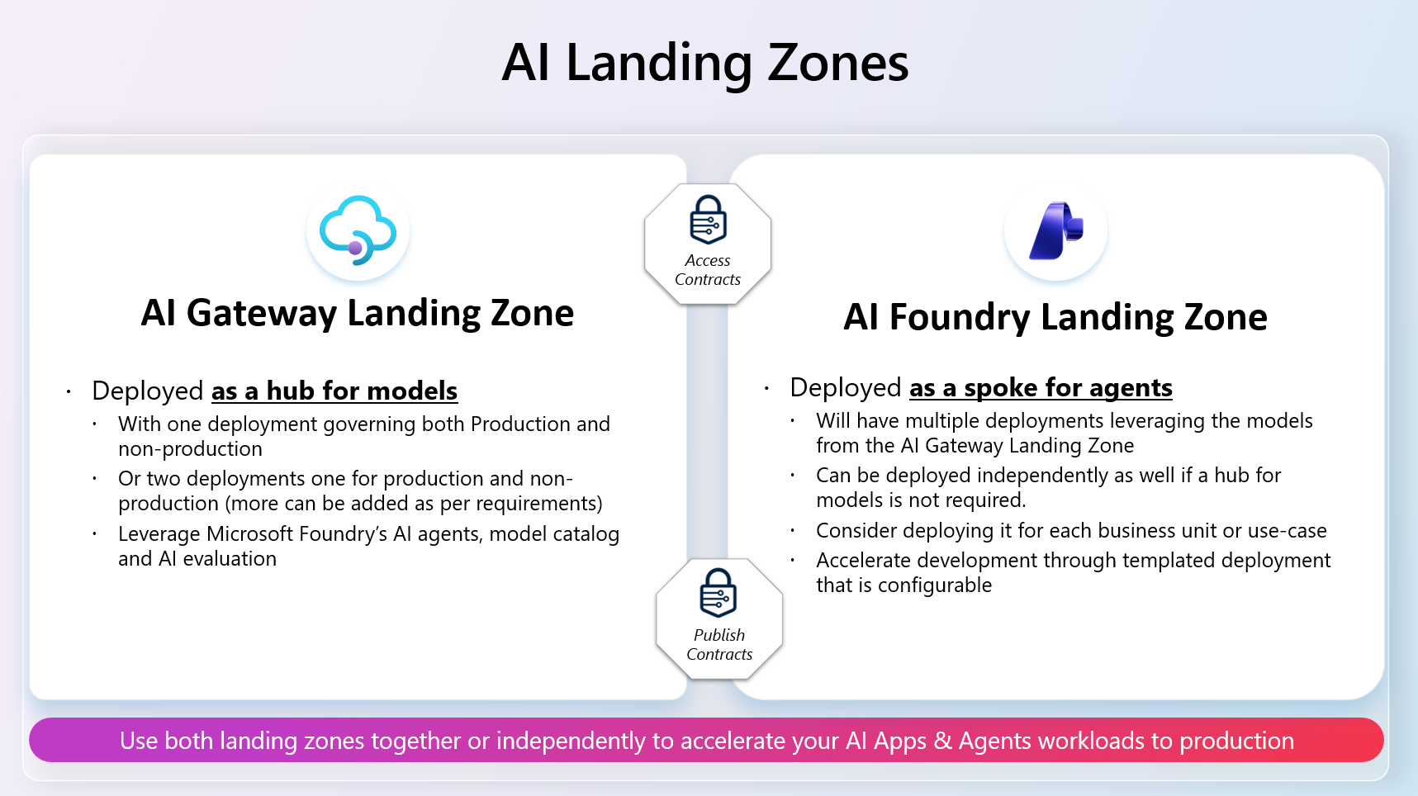
Azure AI Landing Zones

Slide 15
AI Foundry Landing Zone

Slide 16
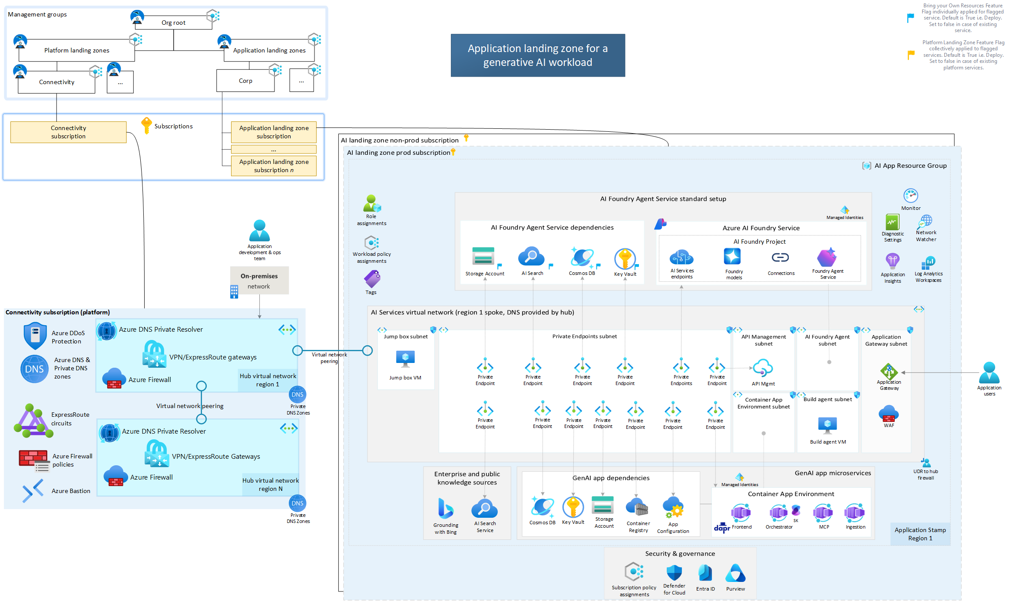
Reference architecture: AI Foundry Landing Zone

Slide 17
AI Gateway Landing Zone

Slide 18
What is an AI Gateway?
1
Concept
A controlled front door between apps and AI services — it centralizes access to models and endpoints.
2
What It Does
Routes requests to approved models, applies policy checks before calls, and standardizes telemetry and controls.
3
What It Is Not
Not just a traffic proxy or a replacement for app logic — it is a governance and operations layer.

Slide 19
Why AI Gateway in Production
Risk Control
1
Enforces authentication and authorization, adds content safety and policy guardrails, and reduces shadow AI usage.
2
Operational Excellence
Observability for prompts, latency, and failures, with rate limits, retries, and fallback patterns for consistent behavior.
3
Business Outcomes
Faster onboarding of new AI use cases, safer scale-out across departments, and lower cost with stronger compliance.

Slide 20
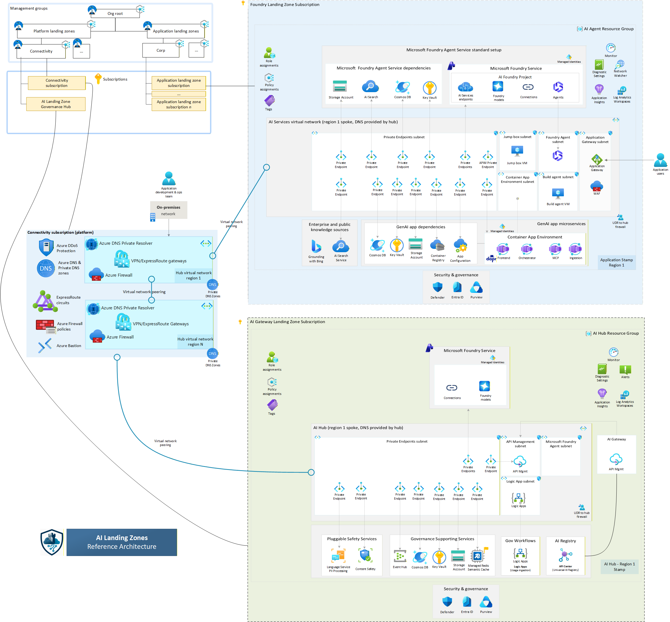
Reference architecture: AI Gateway Landing Zone

Slide 21
Design framework
Compute
Models
Tools
Gateway
Agents
Data
Network
Identity
Monitoringg
Governance
Resource organization
Platform Ops
Reliability
Security
Cost optimization
Operational excellence
Performance efficiency

Slide 22
Design framework
Compute
Models
Tools
Gateway
Agents
Data
Network
Identity
Monitoring
Governance
Resource organization
Platform Ops
Reliability
Security
Cost optimization
Operational excellence
Performance efficiency

Slide 23
Monitoring
You can’t operate in production what you can’t see.
1
2
3
Central telemetry
Quality & drift
Proactive alerts
Diagnostic logs & metrics flow to one Log Analytics workspace
Foundry tracing and evaluations catch model & data drift early
Azure Monitor baseline alerts on health, latency & failures

Slide 24
Governance
Move fast — without giving up control.
1
2
3
Policy guardrails
Approved models
Responsible AI
Built-in Azure Policy for AI on every management group
Allow-list the Foundry catalog — start in audit, then deny
Content Safety + RAI dashboard

Slide 25
Cost optimization
Predictable spend — no bill shock.
1
2
3
Right deployment type
Gateway control
Trim the waste
PTU baseline with pay-as-you-go spillover; global deployments
Token tracking & throttling at the APIM gateway
Auto-shutdown non-prod; cost allocated per project

Slide 26
How we advise customers to start
Start from the reference architecture — don’t build from scratch
Deploy your way: Portal, Bicep or Terraform
Use the Design Checklist for greenfield & brownfield
Anchor decisions in CAF and WAF
Govern from day one — then scale securely, project by project

Slide 27
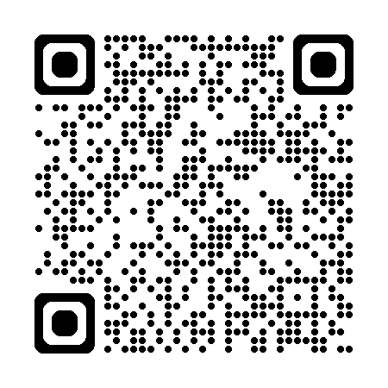
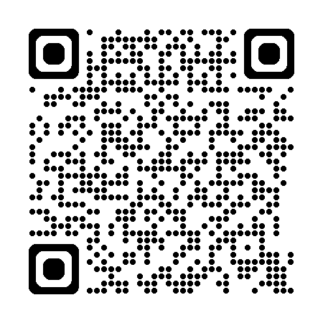
LINKS
AI Landing Zone repo
Citadel repo
Links

Slide 28
Q&A
Christina Pardali
github.com/Azure/AI-Landing-Zones

Slide 29
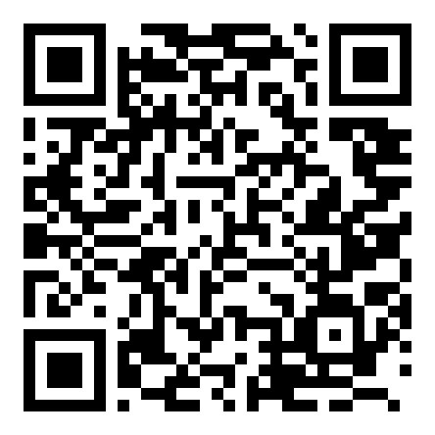
Thank you
Let's connect on LinkedIn
Christina Pardali
github.com/Azure/AI-Landing-Zones
Christina Pardali
linkedin.com/in/christina-pardali

